Slide 1
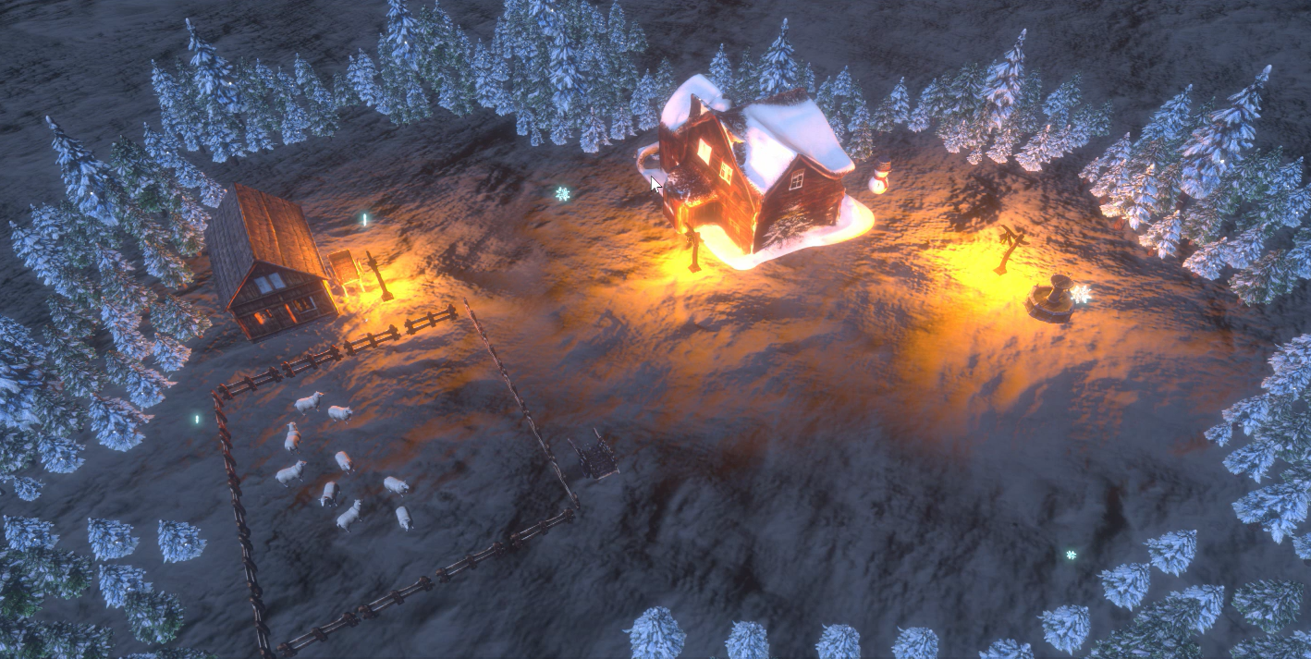
A Cozy Winter Night
DIGCRE Presentation Silvan Monteiro

Slide 2
Table of Contents
Introduction AI topic
Lumalabs AI
Presentation of prototype
Q&A
(Unity Demo)

Slide 3
Introduction AI Topic
3D Model Generation
Improvement of models using Unity 3D technologies
Usage of models in a Unity scene
Goal: Creating a visually decent looking scene

Slide 4
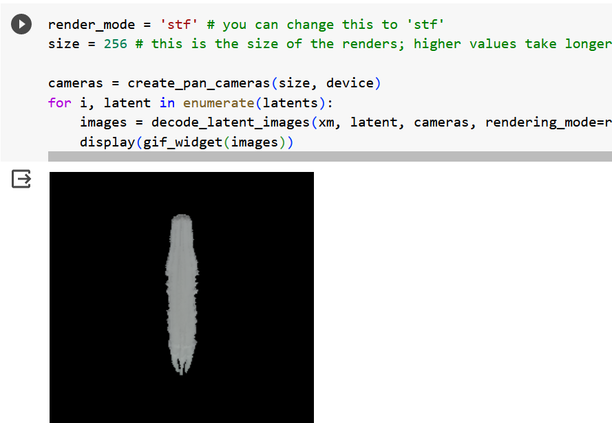
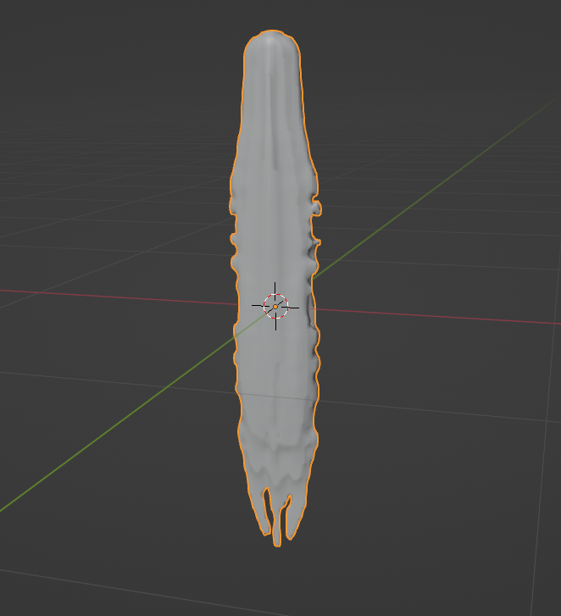
Shap-E (SW05)
Very experimental
Bad quality

Slide 5
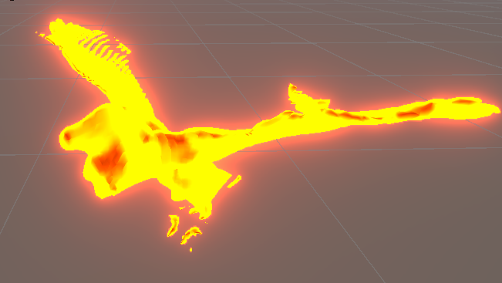
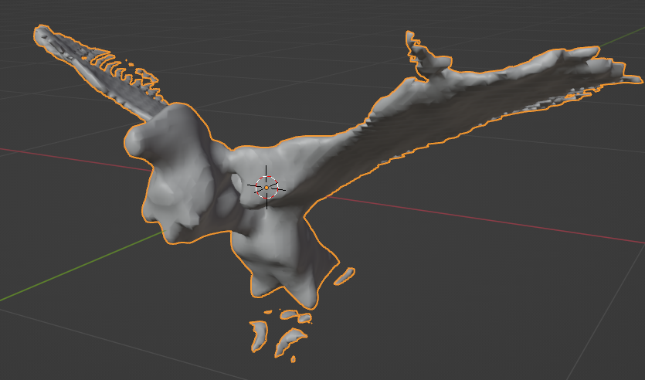
Shap-E after optimization

Slide 6
Lumalabs AI
Works by typing prompts into a discord server
Generates 4 results
Option to refine one or multiple results
Results in higher quality
Model can then be downloaded in various commonly used 3D formats
.fbx
.obj

Slide 7
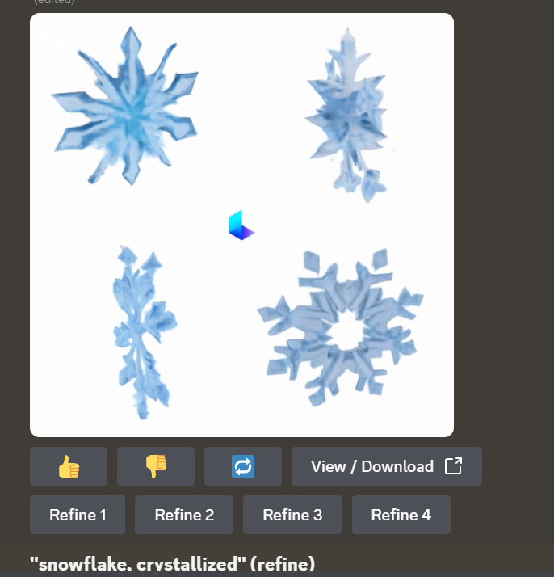
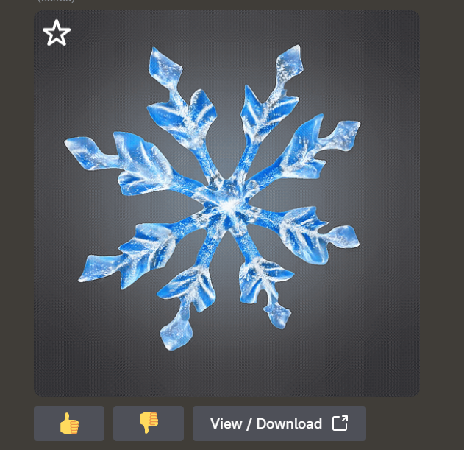
Lumalabs AI (2)

Slide 8
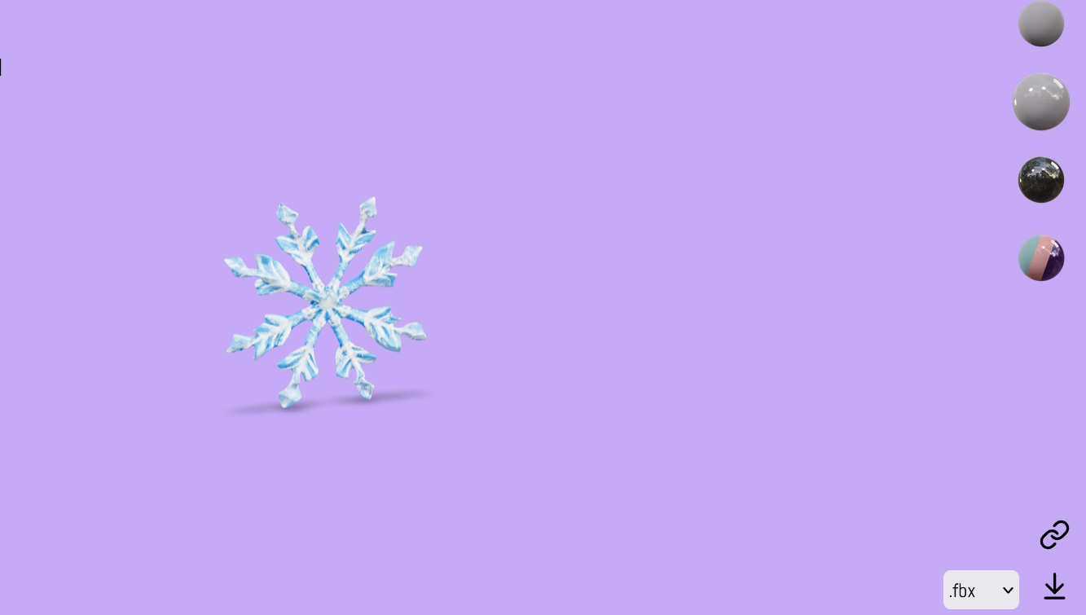
Lumalabs (3)

Slide 9
Limitations
Animating seems difficult
Quality is better than other methods but not comparable to the progress made in image and text generation (yet)

Slide 10
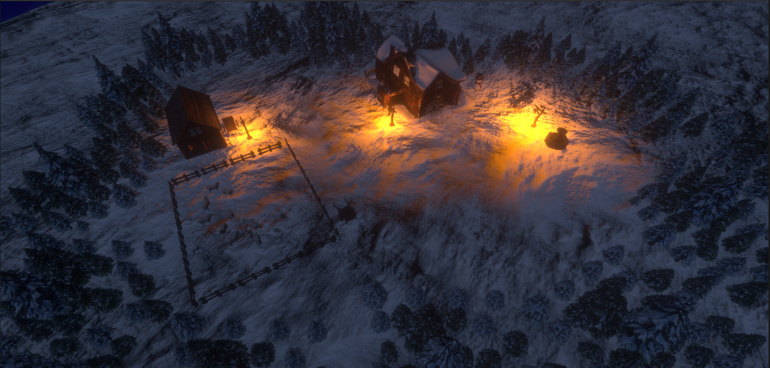
Prototype

Slide 11
Result after Unity postprocessing

Slide 12
VFX Library
Developed Library part of my BA thesis
Can be used by research projects or student projects
The research question of the thesis is to analyze porperties of a Vologram, which is also an AI generated 3D model, but with a different technique
Library also supports regular 3D models

Slide 13
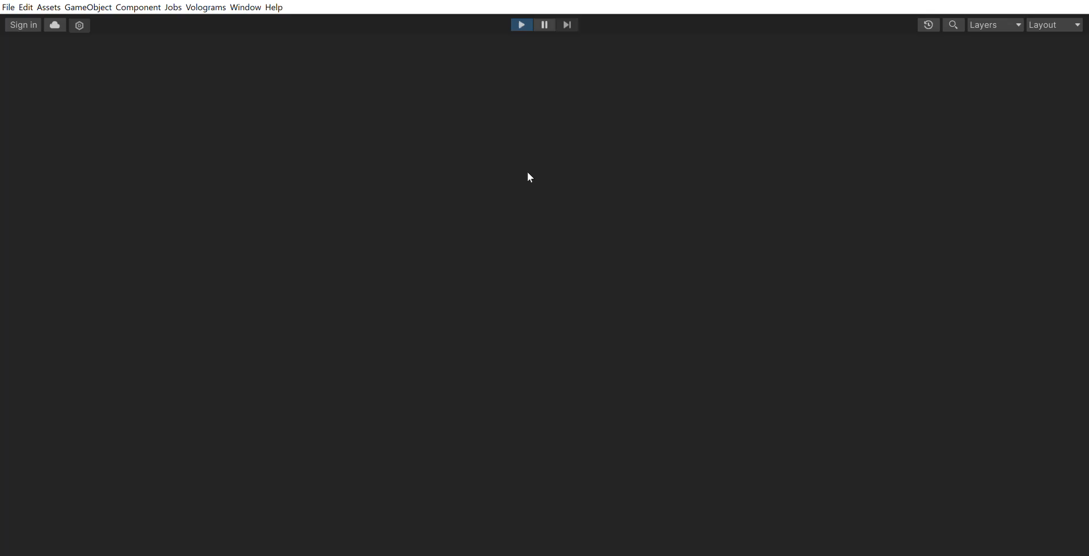
Overview Scene

Slide 14
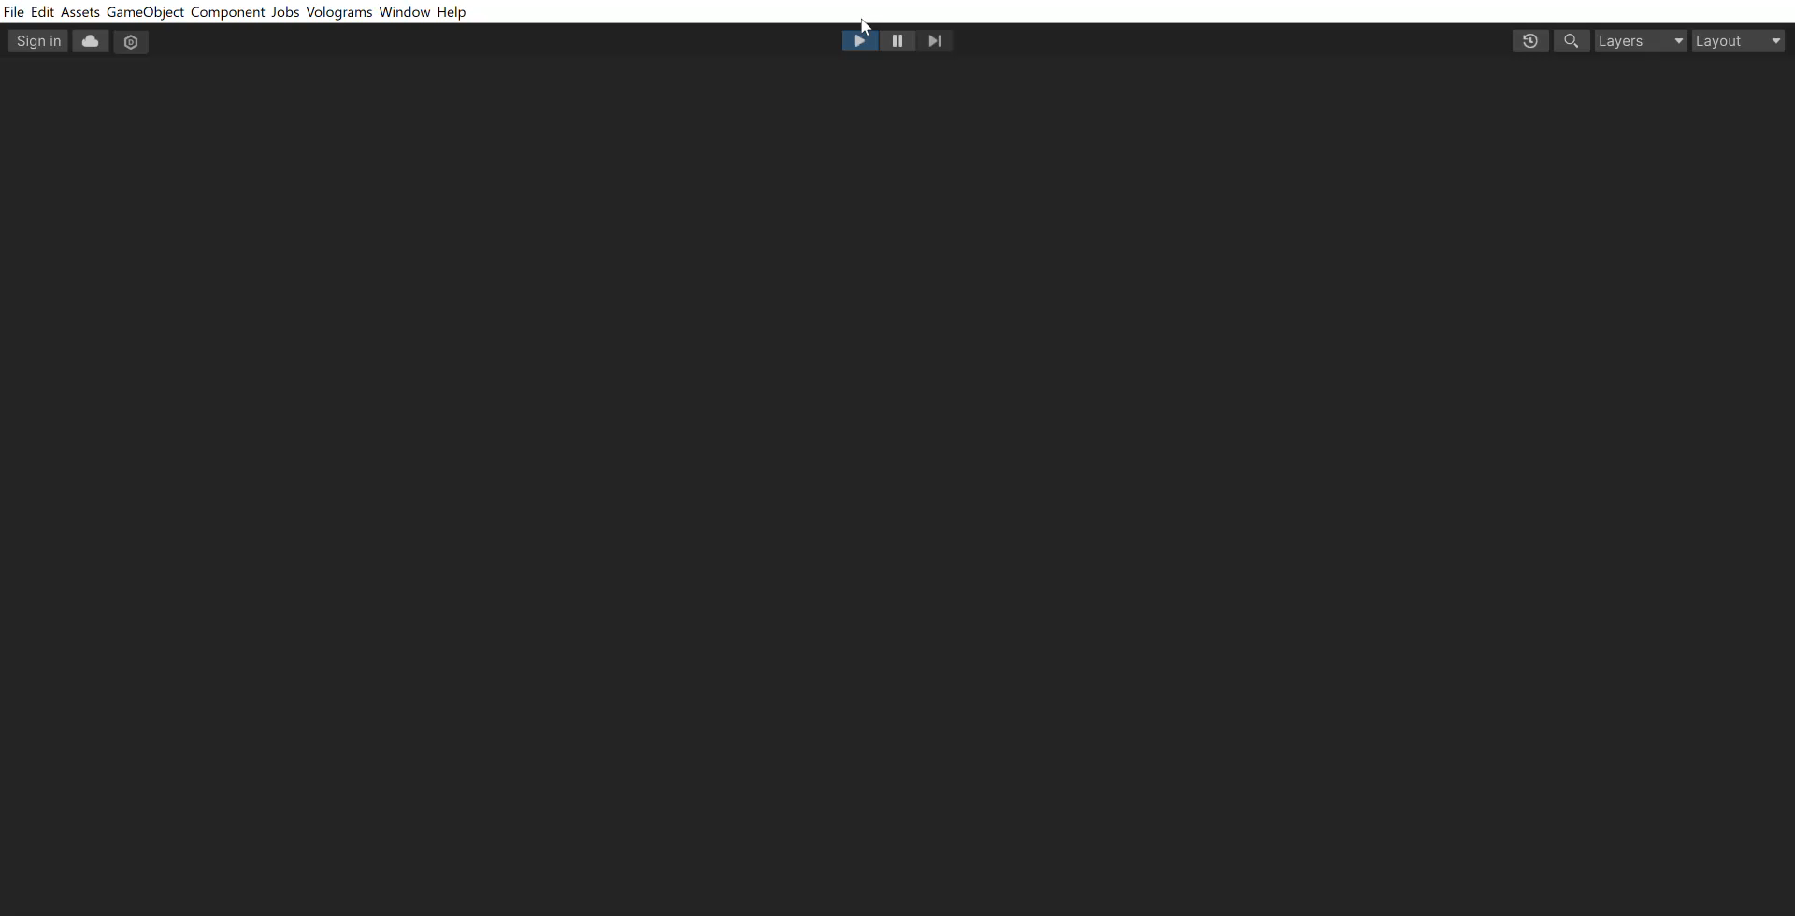
Overview Scene (2)

Slide 15
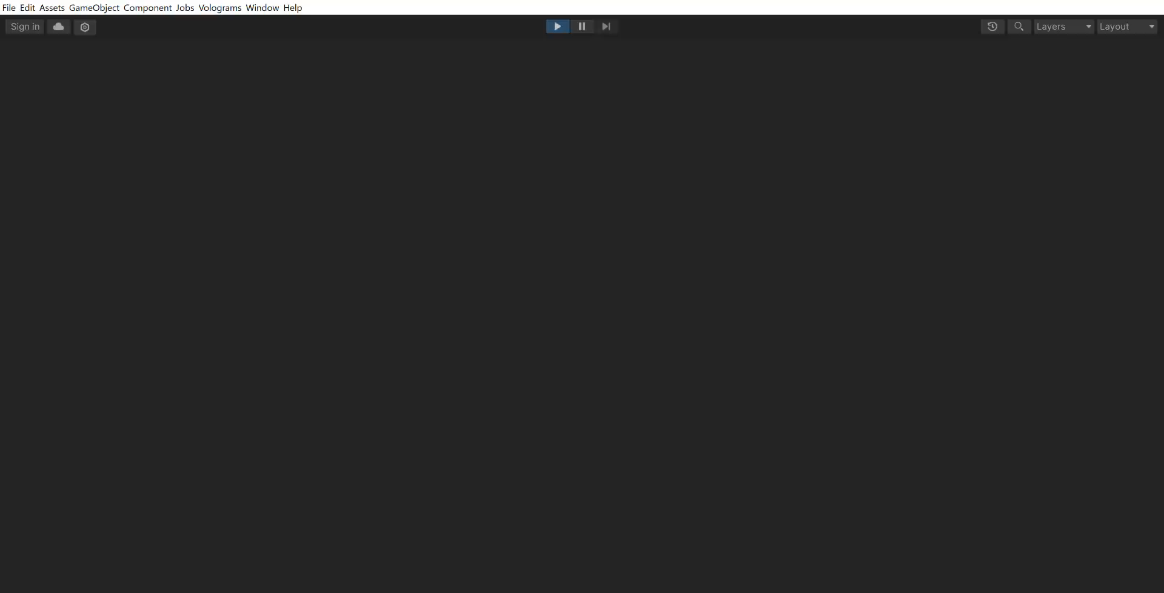
Sheep Scene

Slide 16

Yard Scene

Slide 17
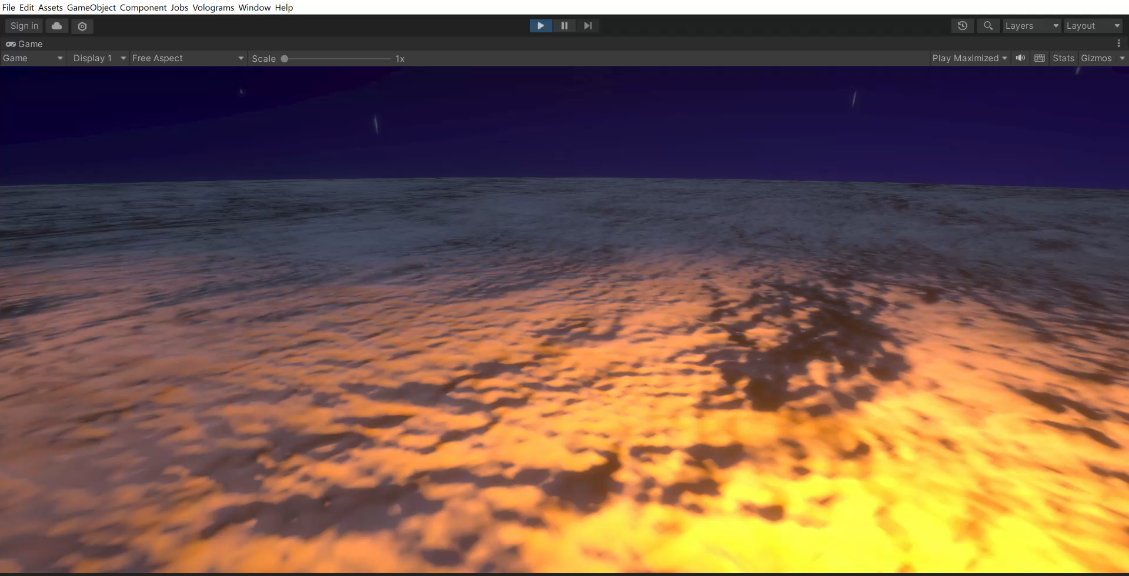
Snowman

Slide 18
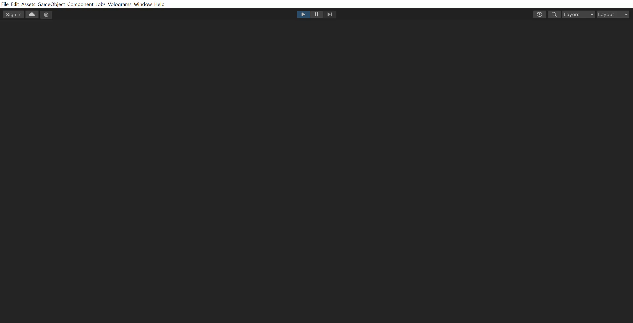
Wolves

Slide 19
Q&A (Unity Demo)
Thank you

